Slide 1
Transverse Learning-Based Classification Of Poultry Diseases For Enhanced Health Management
SlideMake.com

Slide 2
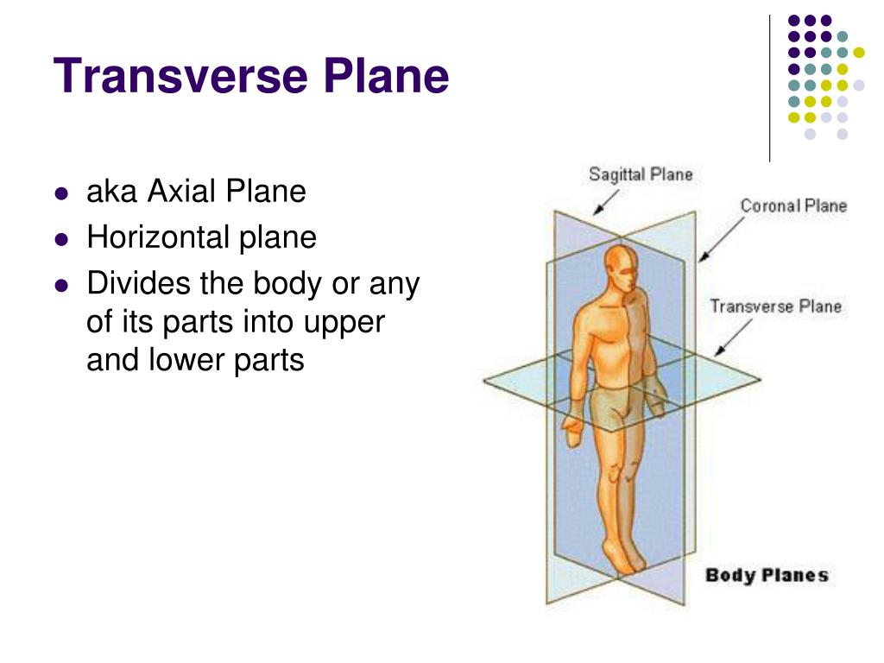
Title SLIDE
Transverse Learning-Based Classification of Poultry Diseases for Enhanced Health Management
Your second bullet
Presented by [Your Name], [Date], [Organization or Institution]
Notes:
Image source: https://image3.slideserve.com

Slide 3
Introduction to Poultry Diseases
Poultry diseases significantly impact global poultry production and food security.
Early and accurate detection is essential for effective disease management and reducing economic losses.
Traditional diagnostic methods often require extensive resources and time, highlighting the need for automated solutions.
Notes:
Image source: https://image3.slideserve.com

Slide 4
Challenges in Poultry Disease Diagnosis
Variability in disease symptoms complicates accurate identification.
Limited access to veterinary expertise in remote areas hampers timely diagnosis.
Existing machine learning models often struggle with generalizing across different disease types and environments.
Notes:
Image source: https://image3.slideserve.com

Slide 5
Overview of Transverse Learning
Transverse learning is a novel machine learning paradigm that leverages shared features across multiple tasks or domains.
It enhances model robustness by transferring knowledge from related tasks to improve classification accuracy.
This approach is particularly suitable for poultry disease classification due to the diverse and overlapping symptomatology.
Notes:
Image source: https://image3.slideserve.com

Slide 6
Methodology of Transverse Learning-Based Classification
The process involves training models on multi-dimensional datasets encompassing various disease features.
Shared representations are learned that capture commonalities among different poultry diseases.
The trained model can then classify unseen diseases or symptoms with improved accuracy and efficiency.
Notes:
Image source: https://image3.slideserve.com

Slide 7
Data Collection and Preprocessing
Data includes images, clinical signs, and laboratory results from multiple poultry farms.
Preprocessing involves normalization, feature extraction, and augmentation to improve model performance.
Ensuring data quality and diversity is critical for effective transverse learning implementation.
Notes:
Image source: https://image3.slideserve.com

Slide 8
Model Architecture and Training
Deep neural networks with shared and task-specific layers are typically employed.
Transfer learning techniques facilitate rapid adaptation to new disease classes.
The model is trained using multi-task learning strategies to optimize classification across all disease types.
Notes:
Image source: https://i1.rgstatic.net

Slide 9
Results and Performance Evaluation
Transverse learning models demonstrate higher accuracy compared to traditional single-task classifiers.
Evaluation metrics include precision, recall, F1-score, and ROC-AUC.
The approach shows promising results in early detection and differentiation of poultry diseases.
Notes:
Image source: https://image3.slideserve.com

Slide 10
Implications for Poultry Health Management
Automated classification enables rapid decision-making and targeted interventions.
Improved disease detection reduces mortality rates and economic losses.
This approach supports sustainable poultry farming through enhanced health monitoring systems.
Notes:
Image source: https://image3.slideserve.com

Slide 11
References
Author(s). (Year). Title of the relevant research paper or source. Journal/Conference, Volume(Issue), pages.
Your second bullet
Additional references on machine learning, transverse learning, and poultry disease diagnostics.

